Slide 1

BLOG MANAGEMENT
1.Riya Sawant -20104078
2.Ritvik Shetty -20104067
3.Srusti Patil -20104066
4.Tanishq Sahane-20104072
Project Guide
Prof .Jayshree Jha
.

Slide 2
Contents
Introduction
Objectives
Scope
Features / Functionality
Project Outcomes
Technology Stack
Screenshots from the project

Slide 3
1.Introduction:
A blog is a type of website that is updated regularly with new content .Most blogs contain short ,informal articles called blog posts. These posts usually contain some combination of text ,photos, videos and other media. At its core , a blog is just a space on the Web that you can create to record and express your opinions , experiences and interests. This application has few advantages:
To share knowledge.
To create awareness.
To Stay in touch.
.

Slide 4
2.Objectives:
1.To build a user-friendly application.
2.To share thoughts , ideas ,points of view with bloggers around the world.
3.To Express ideas or concepts in an open ,unrestricted web space.

Slide 5
3. Scope
1.Can be useful for learning and applying new things that helps to enrich your skills and knowledge.
2.Can share knowledge to others users in world and can attract other users towards the topic.
3.Can be used to like and dislike blogs.
4. Can be used to improve your writing skills.

Slide 6
4. Feature /Functionality
1. User can create blog of any category.
2. Get Personalised experience of reading blogs of your favourite category.
3. Can view the blogs already created by the user to edit or delete.
4. Can also get a look of trending blogs available.
5. If the user uses any forbidden words while creating blog,it will show an error and will ask the user to remove that word from the blog.

Slide 7
5. Outcome of Project
1. User can Login in his/her account .
2. User can create blogs and read blogs.
3. There is an admin login where we can delete users and add blogs.

Slide 8
6. Technology Stack
Frontend : Python
Integrated development environment(IDE)-Vs Code
Backend: MySQL (using phpMyAdmin)
4. Designer: PyQT5

Slide 9
Homepage
Login Page
Admin page
Login
Register
Admin Login
Add Blogs
Manage Blogs
Logout
Main Page
Logout
Favourite
Read Blogs
Create Blogs

Slide 10
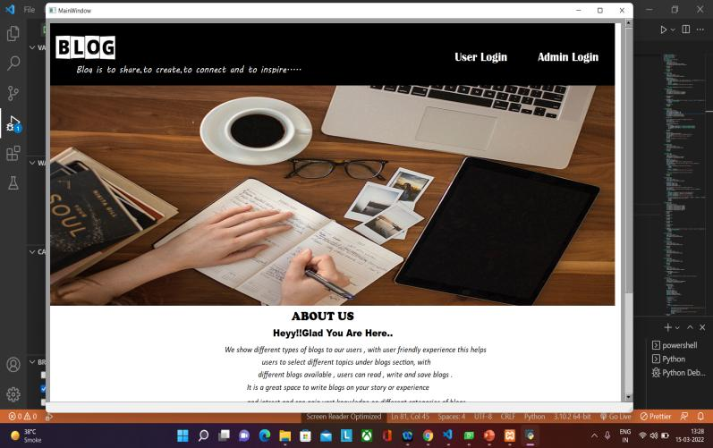
Screenshots from the project:
Main page:

Slide 11
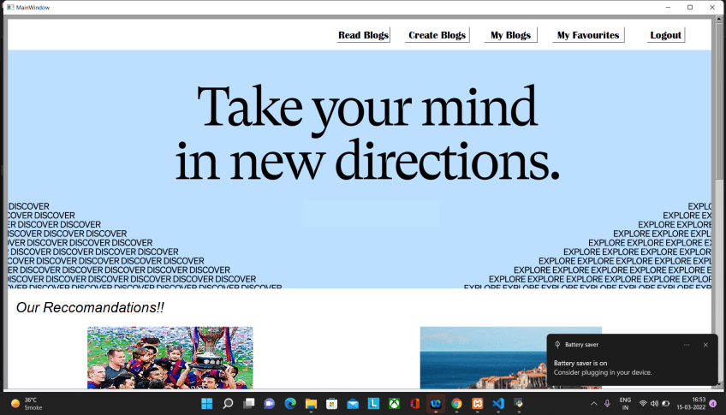
Home Page:

Slide 12
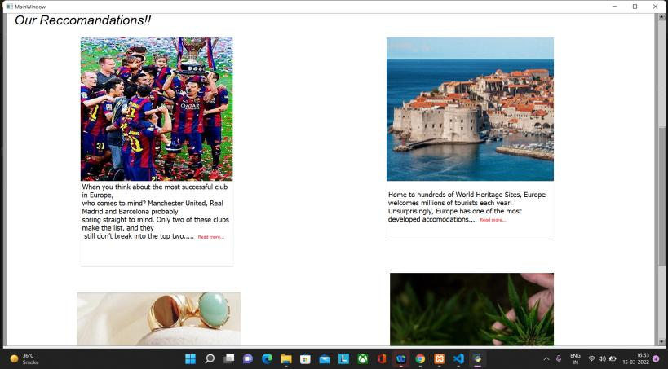
Our Recommendations:

Slide 13
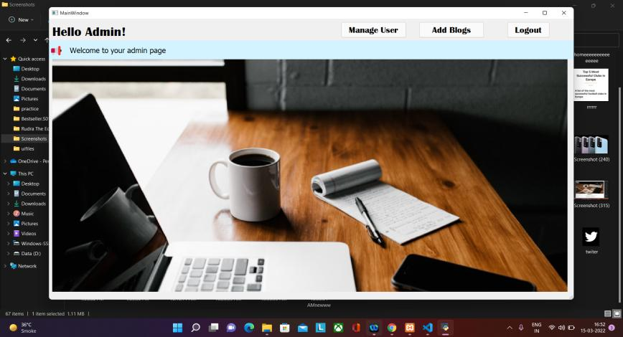
Admin Page:

Slide 14
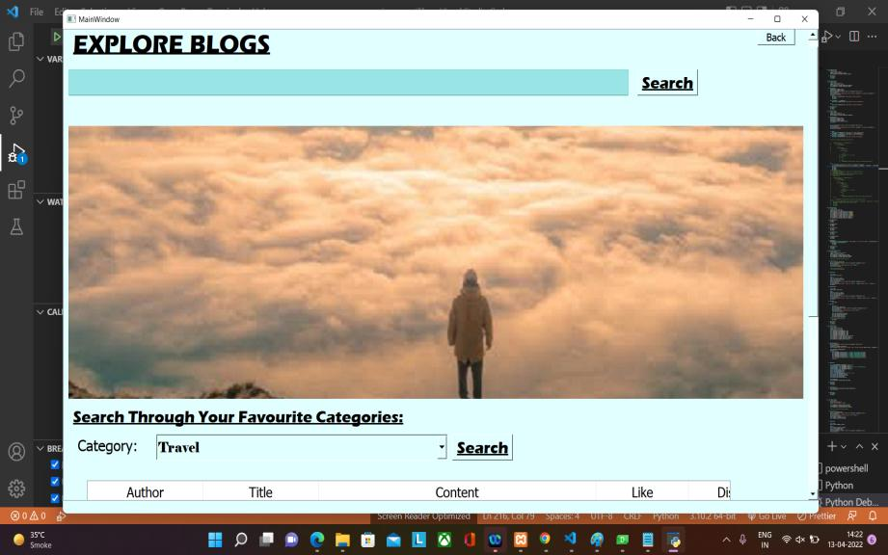
Explore Blogs:

Slide 15
Thank You...!!

